Slide 1
Microsoft 365 platform community call
aka.ms/m365pnp
Your host in this call: Vesa Juvonen
September 6, 2022

Slide 2





Agenda
Latest updates and news on the Microsoft 365 platform
Updates on the Microsoft Teams documentation
Group picture time with Together Mode!
Demos
Brian Jackett and Cameron Parker - Latest on eDiscovery Premium APIs on Microsoft Graph
Alex Terentiev and Vesa Juvonen – New features in SharePoint Framework 1.16
Merill Fernando - Introduction to Microsoft Graph X-Ray project

Slide 3
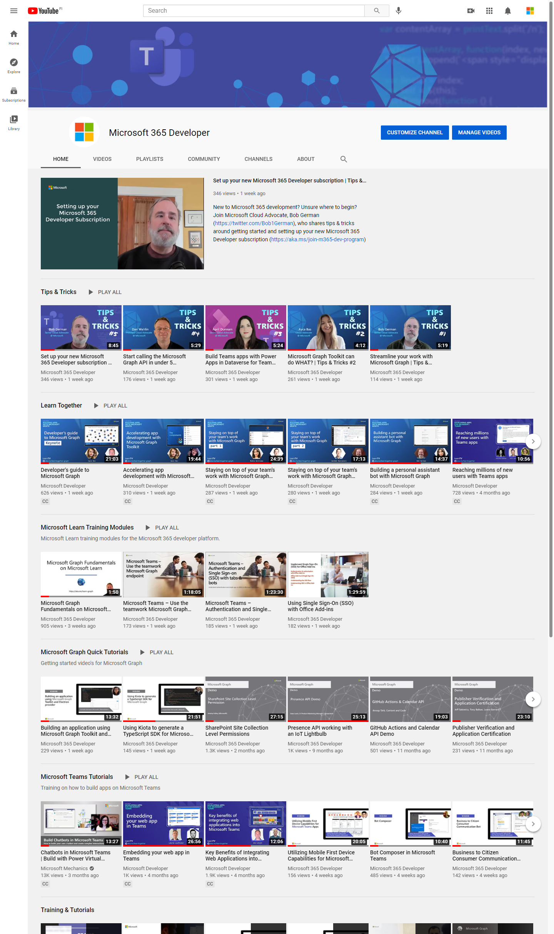
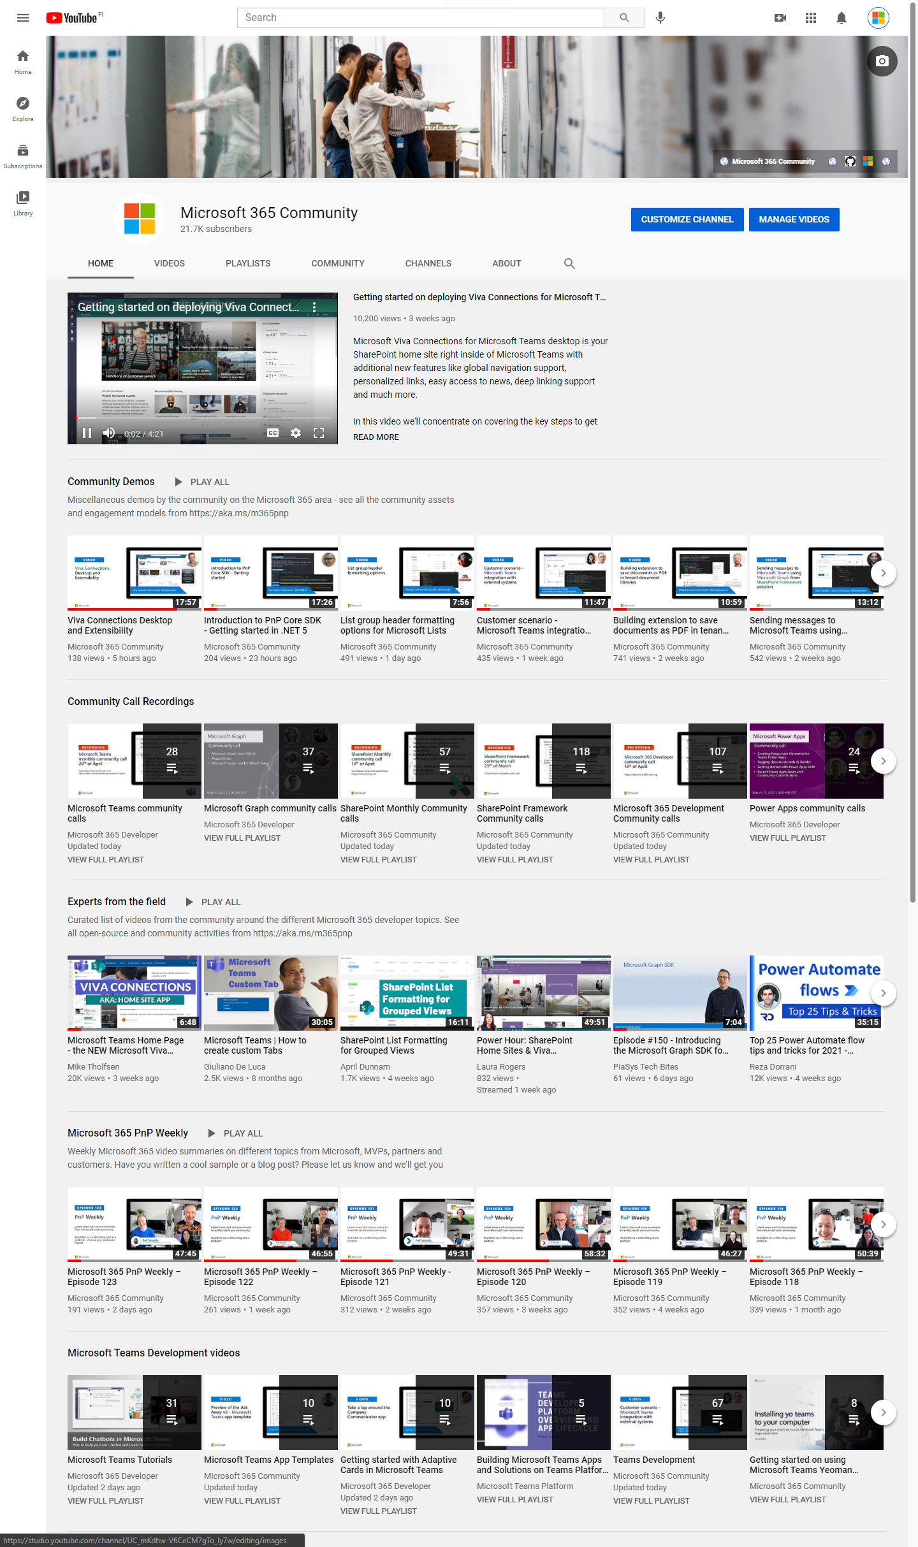
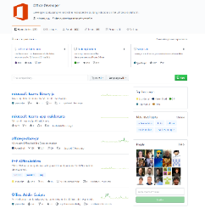
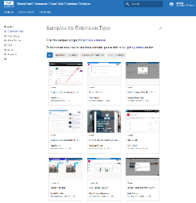
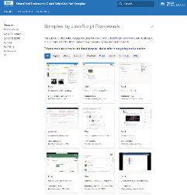
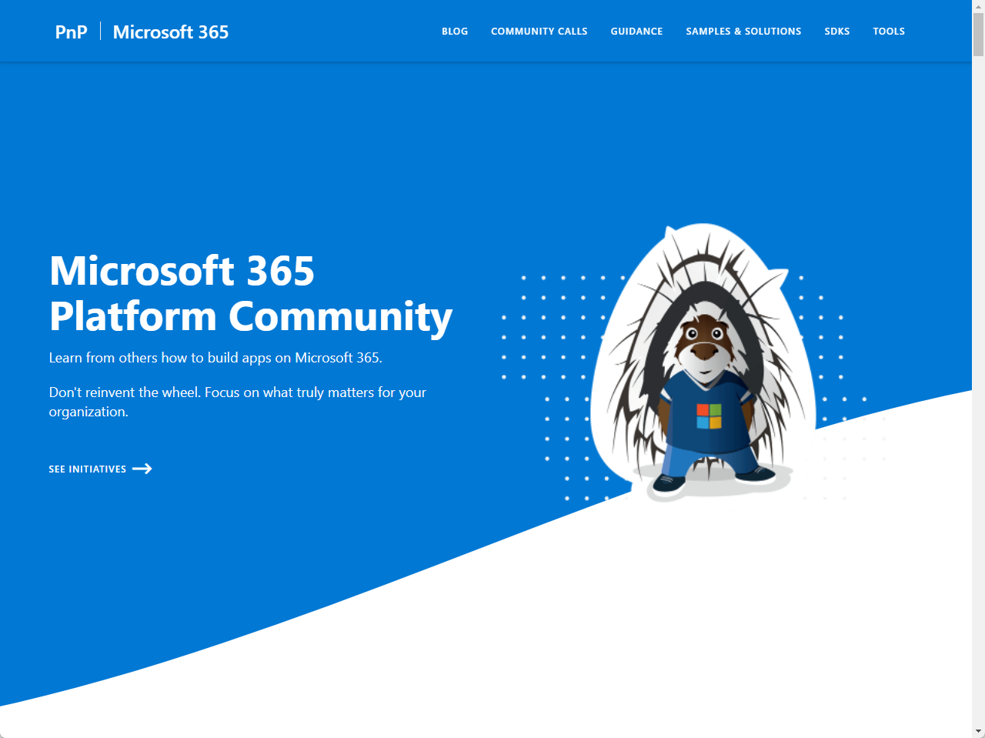
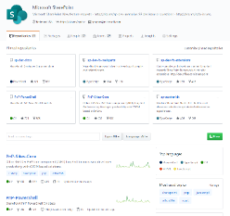
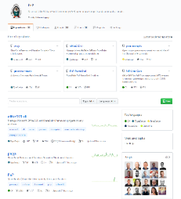
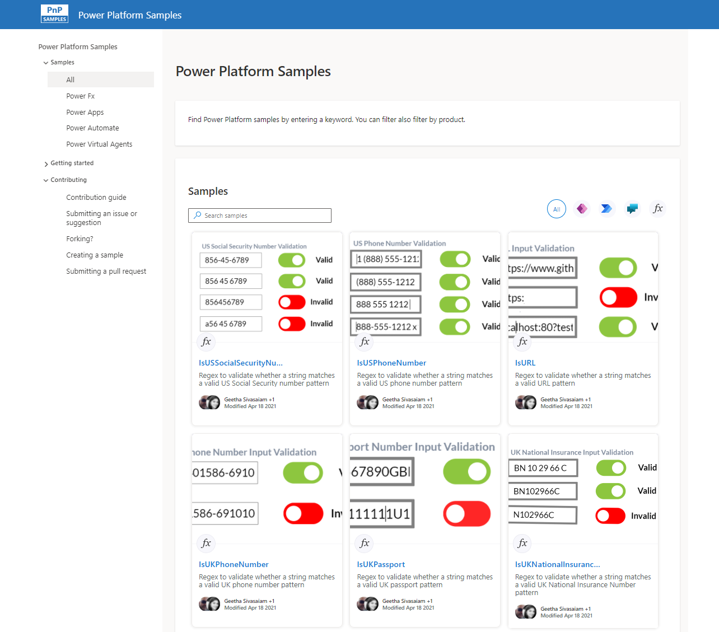
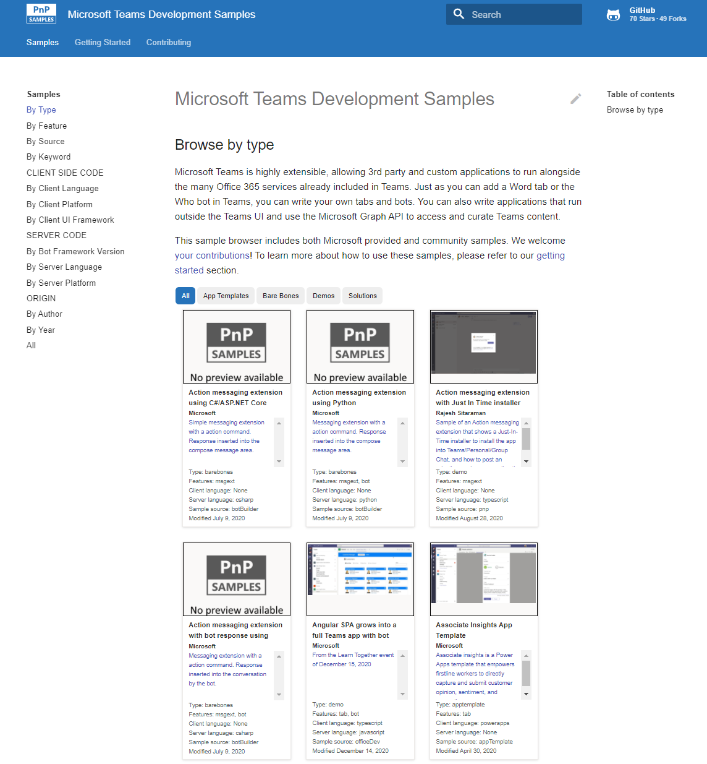
Microsoft 365 developer videos
Microsoft 365 community videos
Open-source
Sample galleries
Open-source initiatives and samples
aka.ms/m365devyoutube
aka.ms/m365/videos
github.com/pnp
github.com/officedev
github.com/sharepoint
github.com/microsoftgraph
aka.ms/m365/samples
aka.ms/teams-samples
aka.ms/spfx-webparts
aka.ms/powerplatform-samples
aka.ms/spfx-extensions
aka.ms/list-formatting
aka.ms/m365/community
@Microsoft365Dev | @m365pnp

Slide 4
Microsoft 365 developer community calls
Microsoft 365 platform (weekly) https://aka.ms/m365-dev-call
Adaptive Cards https://aka.ms/adaptivecardscommunitycall
Microsoft identity platform https://aka.ms/IDDevCommunityCalendar
Office Add-ins https://aka.ms/officeaddinscommunitycall
Power Platform https://aka.ms/PowerAppsMonthlyCall
Microsoft 365 and Power Platform community (bi-weekly) https://aka.ms/m365-dev-sig
Viva Connections & SharePoint Framework (bi-weekly) https://aka.ms/spfx-call
Download recurrent invites from
https://aka.ms/m365/calls
Notes:
m365-dev-sig

Slide 5
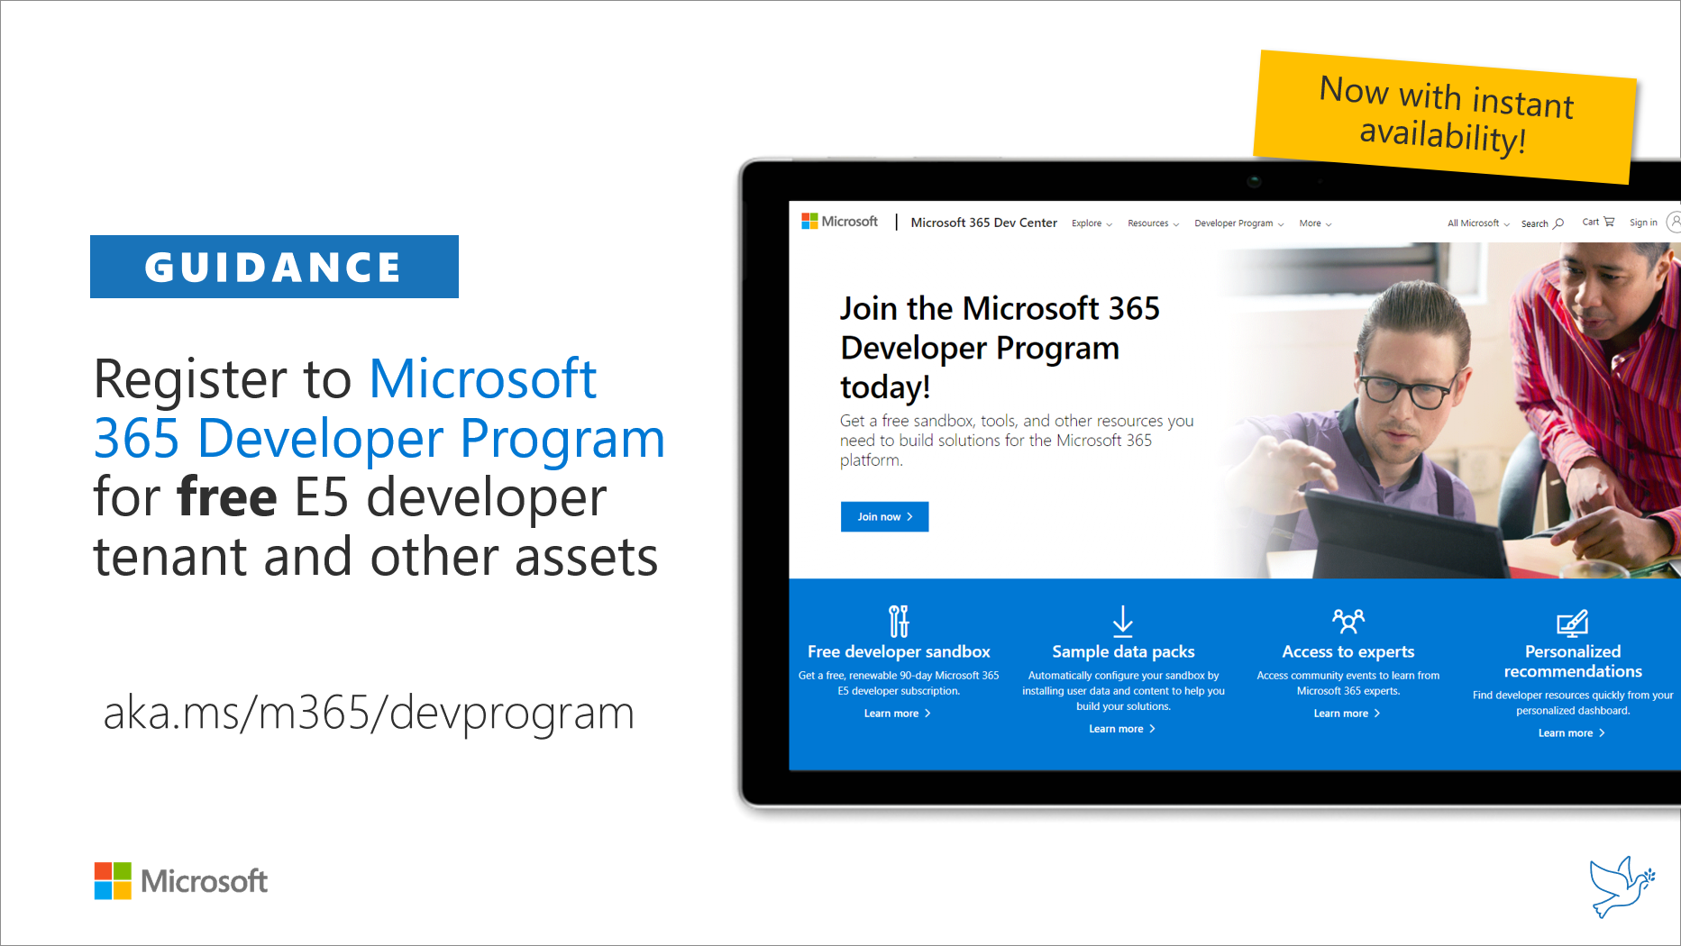
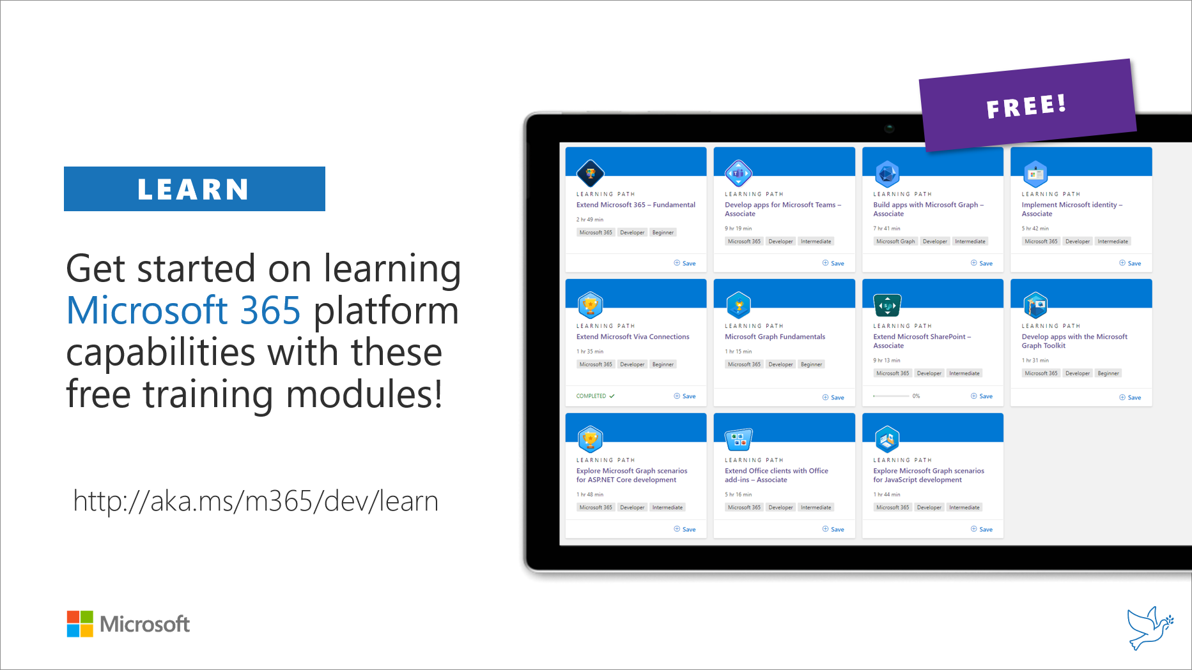
Getting started assets for Microsoft 365 dev
aka.ms/m365/devprogram
aka.ms/m365/dev/learn

Slide 6
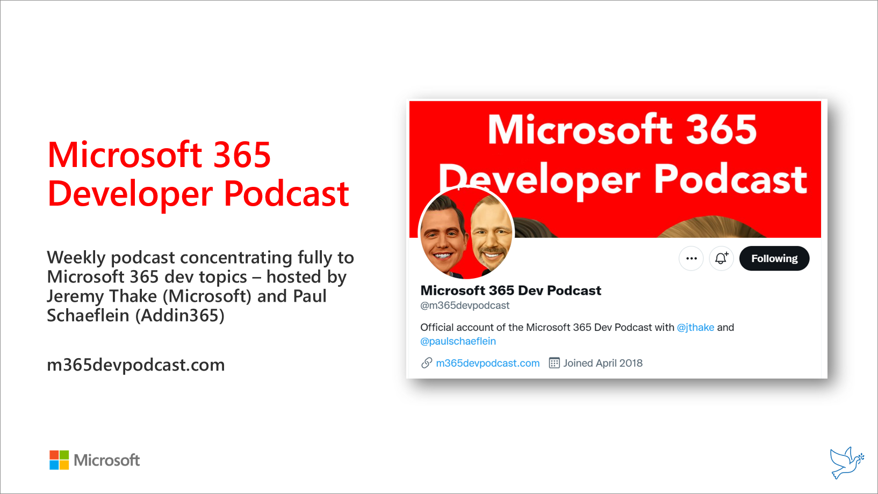
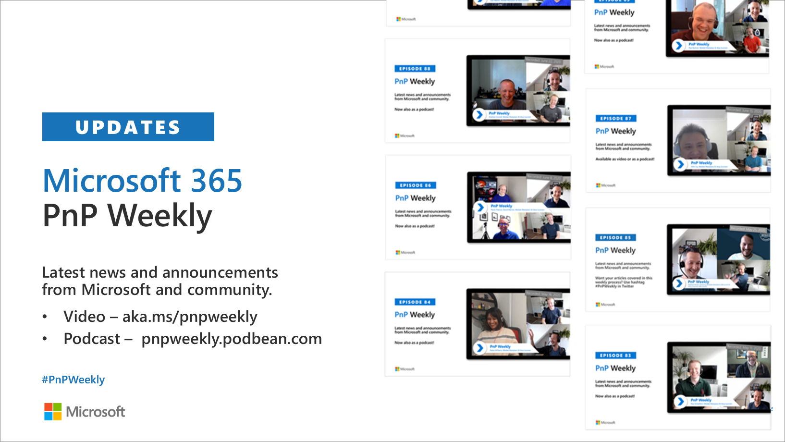
Microsoft 365 Developer podcasts
m365devpodcast.com
Video – aka.ms/pnpweekly
Podcast – pnpweekly.podbean.com

Slide 7
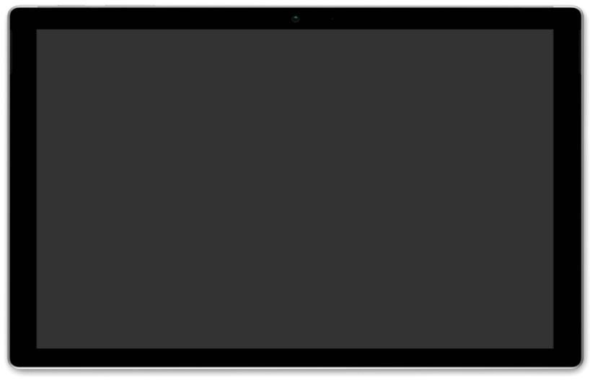
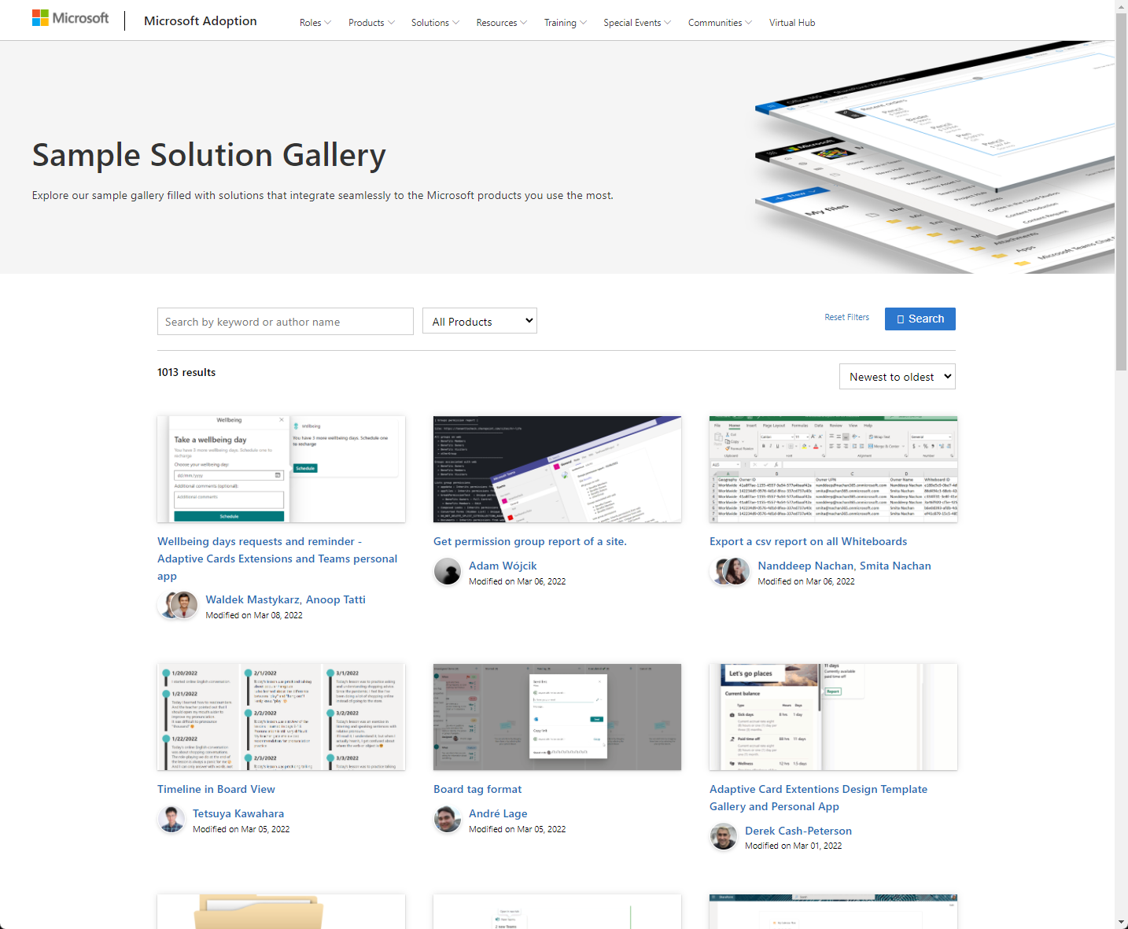
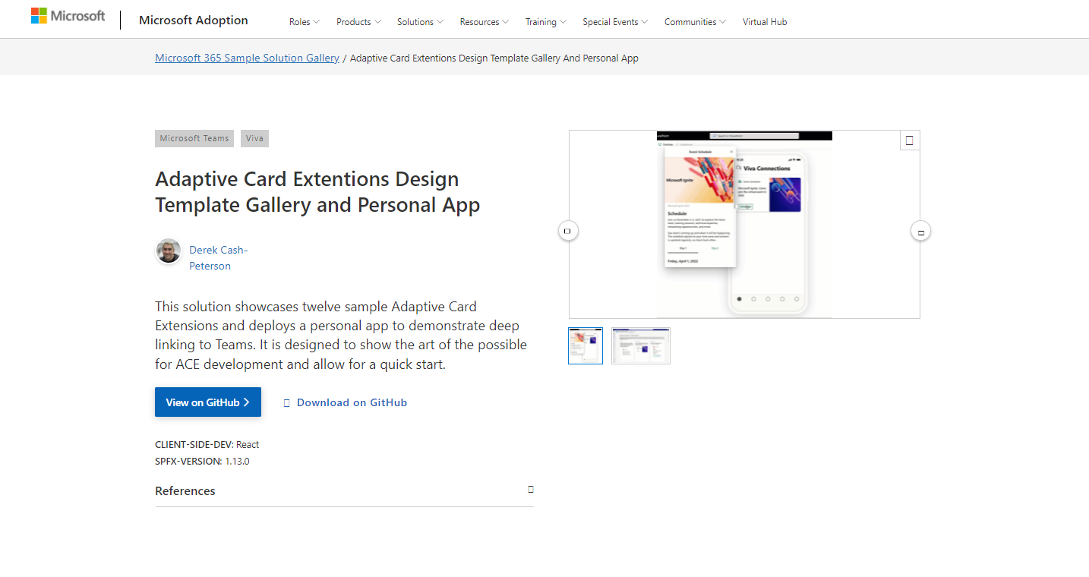
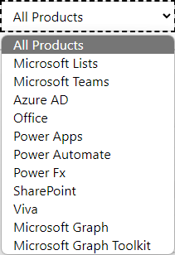

SAMPLES
New Microsoft 365 sample gallery with more than 500 samples from Microsoft and community
1100
aka.ms/m365/samples

Slide 8
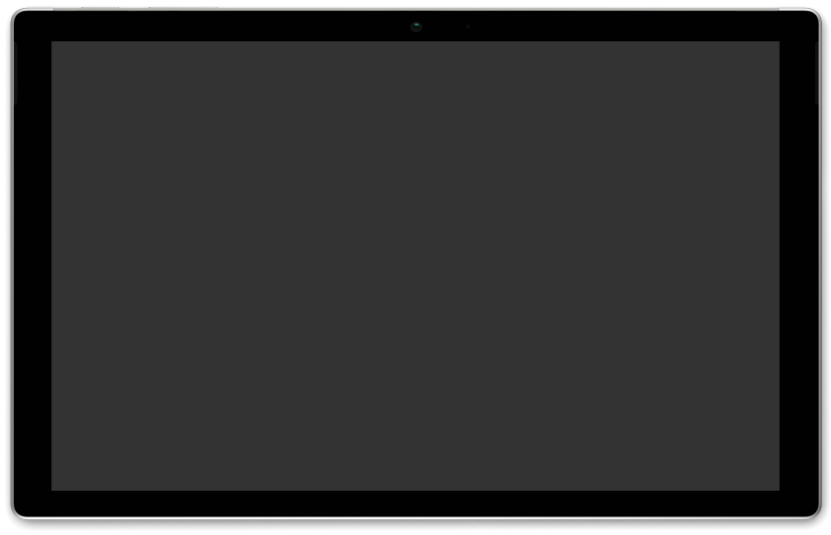
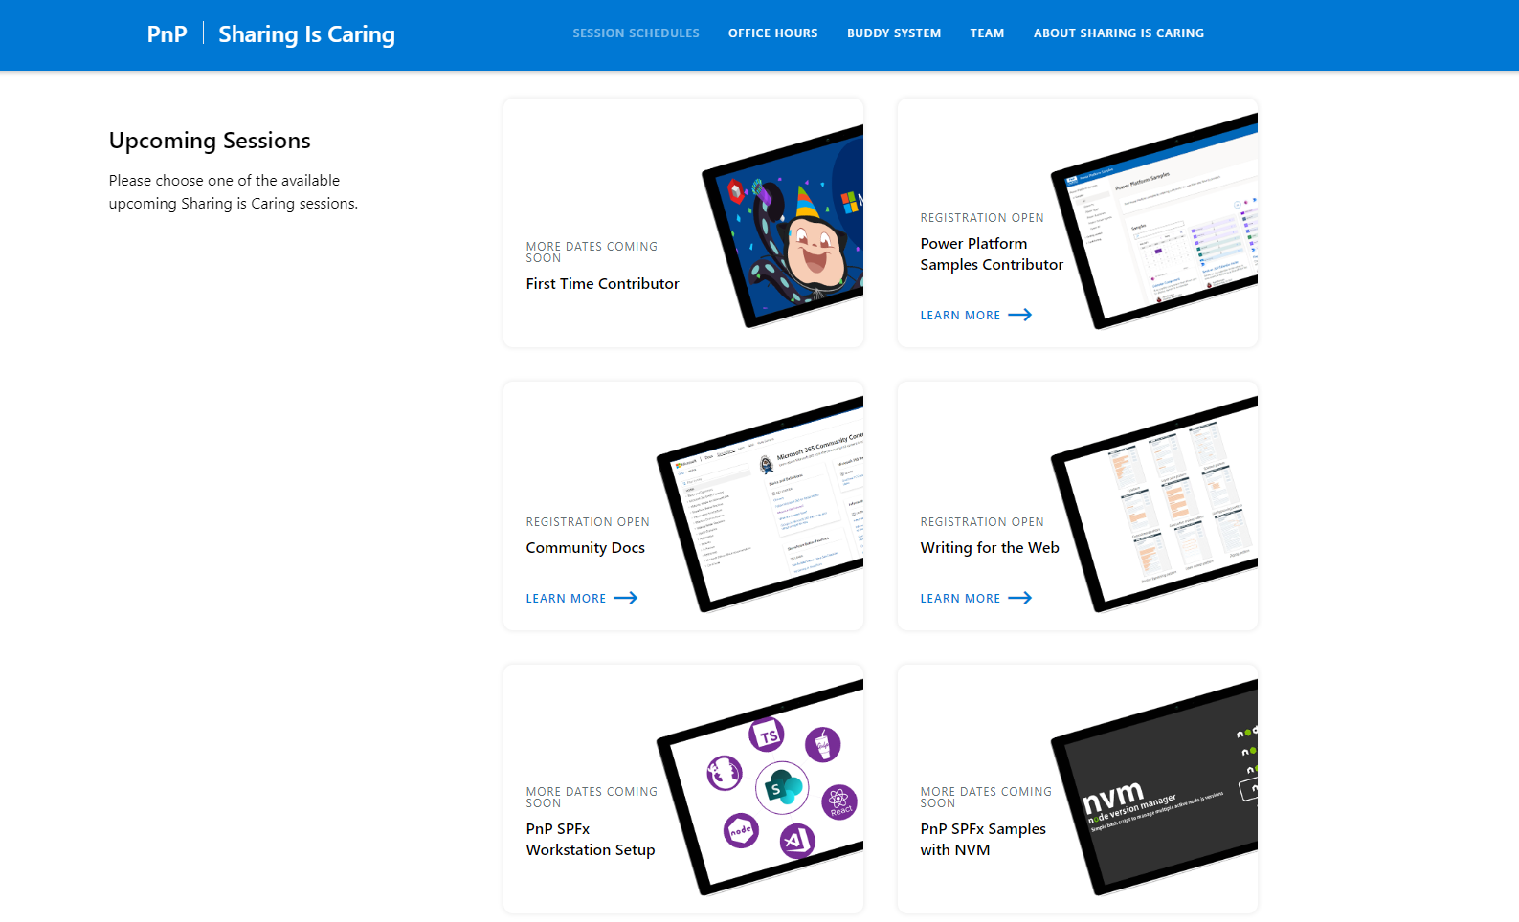
GUIDANCE
Learn how to get started in the open-source PnP community!
Upcoming Sessions:
General First Time Contributor
Power Platform Samples Contributor
Writing for the Web
SPFx Developer Workstation Setup
Using PnP SPFx samples w/ NVM
More than code with VS Code
First-time presenter
M365 Maturity Model Practitioners
Power Platform Samples Contributor
Power Platform
Conference Session
https://aka.ms/sharing-is-caring
Notes:
25 Total attendees, 16 attendees who attended both First-Time Contributors and Community Docs sessions.

Slide 9

Please provide us input around your current experiences on Microsoft Teams development – we would like to hear from you!
https://aka.ms/TeamsDevSurvey2022

Slide 10

https://aka.ms/app-camp

Slide 11

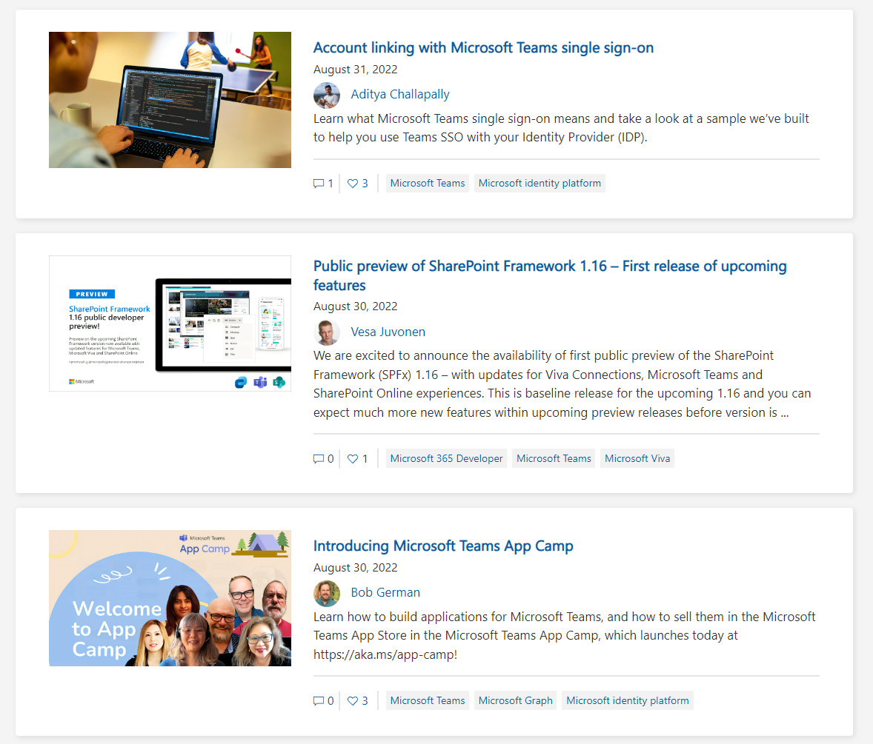
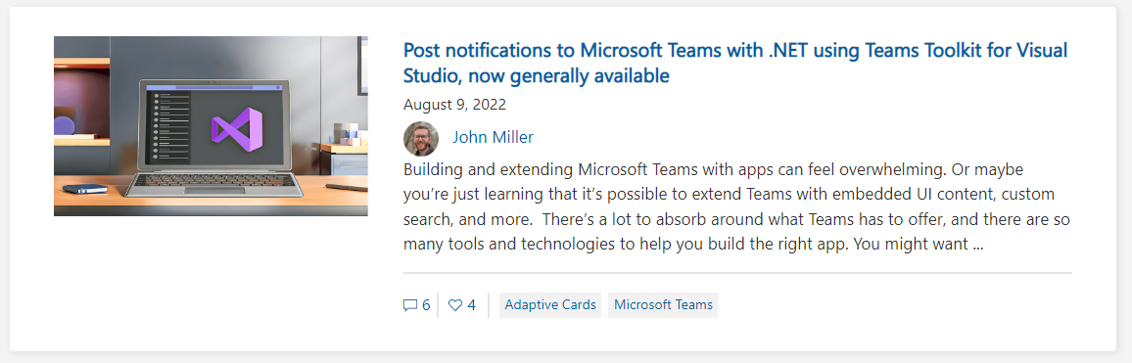
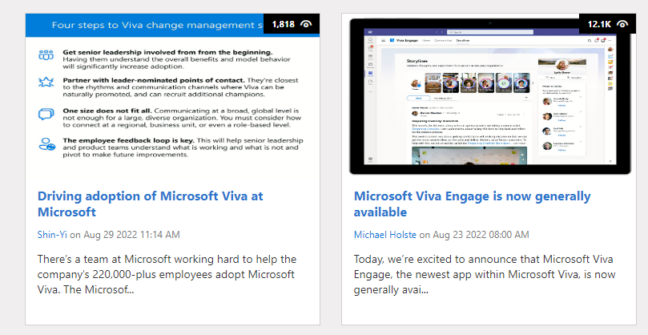
https://aka.ms/m365dev/blog
https://aka.ms/teams/blog
https://aka.ms/microsoftviva/blog
https://aka.ms/sp-blog
Notes:
We’re excited to announce the availability of additional calling and meetings experiences for customers using Microsoft Teams in a virtual desktop infrastructure (VDI) environment.

Slide 12
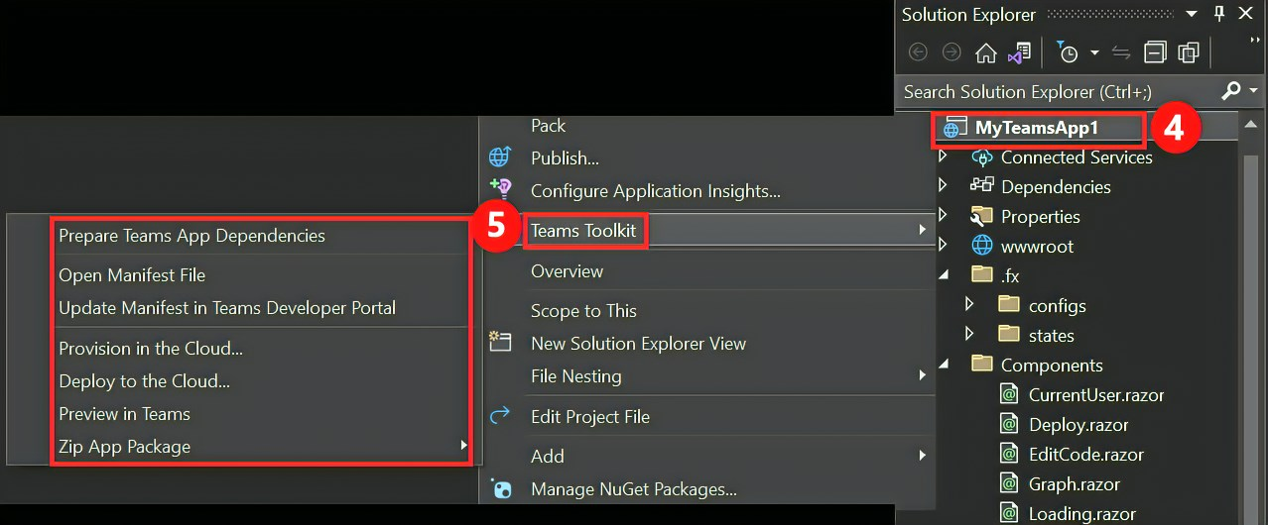
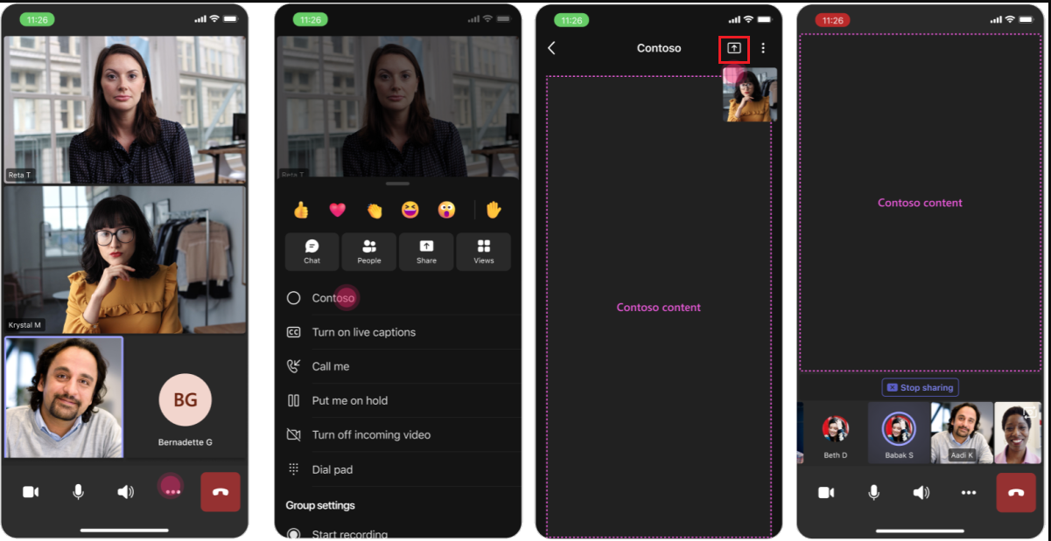
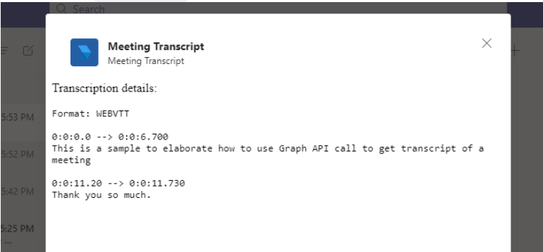
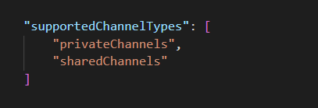






Teams Platform updates Feature update
1
Teams Toolkit for Visual Studio is GA in Visual Studio 2022
3
Share apps to the Teams meeting stage in mobile (Dev Preview)
Docs: http://aka.ms/TeamsDevDocs > Tools and SDK > Teams Toolkit for Visual Studio
2
Retrieving meeting transcripts in the post-meeting scenario (Beta).
4
Enable your app for shared channels
Docs: http://aka.ms/TeamsDevDocs > Build Tabs > Build apps for shared channels
Docs: http://aka.ms/TeamsDevDocs > Build apps for Teams meetings and calls > Get meeting transcripts
5
Developer Portal is now GA and App Studio is deprecated
Developer Portal: https://dev.teams.microsoft.com/
@Microsoft365Dev
aka.ms/TeamsPlatformUpdates
aka.ms/TeamsDevDocs
aka.ms/TeamsSamples
aka.ms/TeamsPlatformFeedback
Notes:
Wajeed covering 9/6/2022 Hello everyone. With respect to Teams platform, we have bunch of updates from last two months. Today, I'll be covering few highlights. For more detailed updates, please visit What's New section of Microsoft Teams Developer documentation.
So the first update is on – Teams Toolkit for Visual Studio 2022 is now GA Teams Toolkit for Visual Studio helps you to create, debug and deploy Microsoft Teams apps.
Second update is on Meeting Transcript, Graph APIs to fetch meeting transcript is not available in Beta. We also have sample code linked from the documentation.
Next we have support for Share to Stage in Mobile. Please note that this is currently in Developer preview.
Fourth update is on Shared channels. We have added new property in manifest called "supportedChannelType" in manifest. This allows you to specify if your app is supported in Shared and Private channels.
Last one is just a reminder that App Studio is completely deprecated. Please use Developer Portal going forward to Configure, distribute, and manage your Teams apps.
So, these were the platform updates, if you have any feedback or suggestion, please post on aka.ms/TeamsPlatformFeedback- the link is available in the footer. You could also follow us on twitter and configure to the RSS feeds to get regular platform updates.

Slide 13
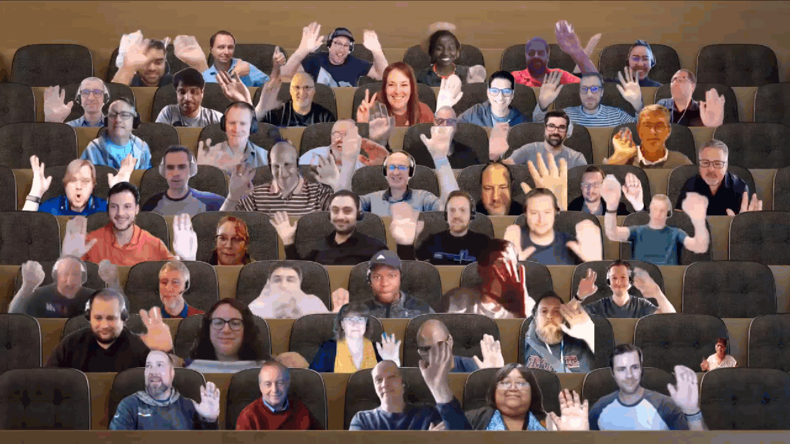

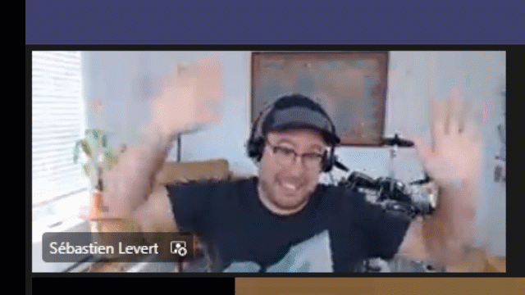
Optional picture time!
Video on and we’ll grab a Together Mode pic with those who are willing to do this.
We are together on this as a community!
Let’s all be like Seb
By enabling your camera for the picture, you grant us permission to share your picture in social media.

Slide 14


DEMO
Latest on eDiscovery Premium APIs on Microsoft Graph – Brian Jackett
– Cameron Parker
New features in SharePoint Framework 1.16
– Alex Terentiev
– Vesa Juvonen
Introduction to Graph X-Ray project
– Merill Fernando

Slide 15


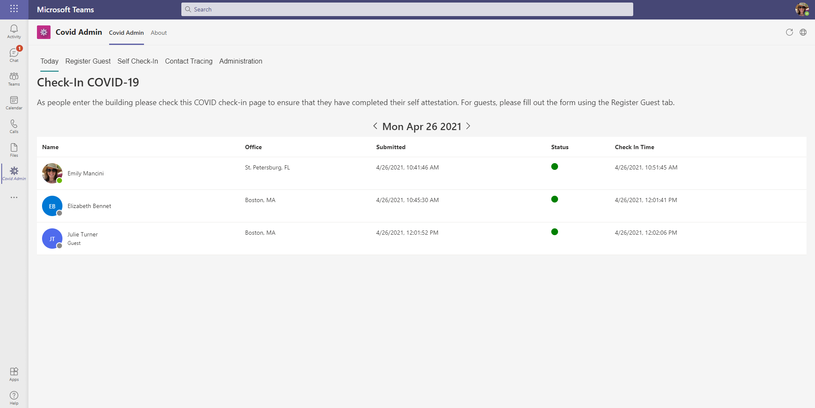
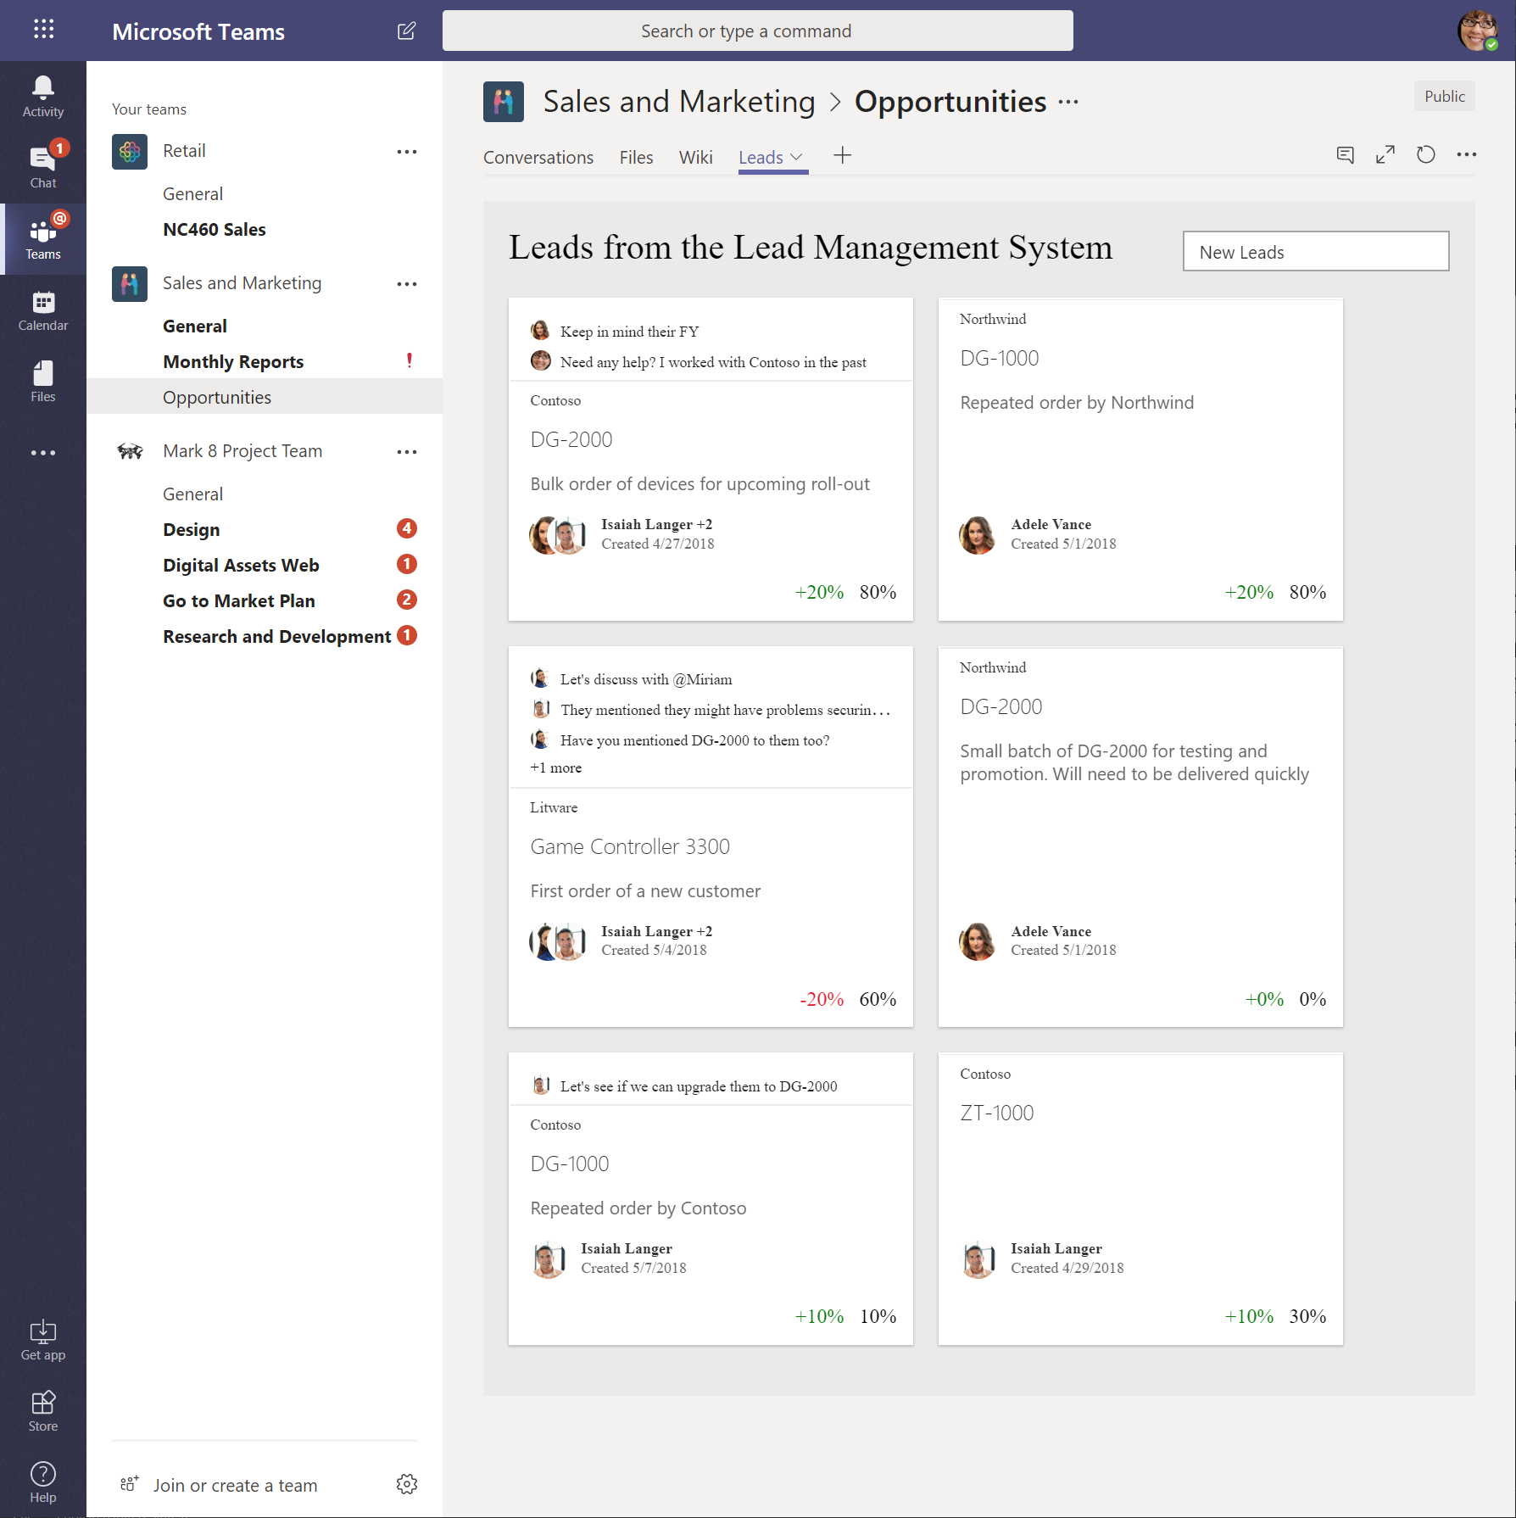
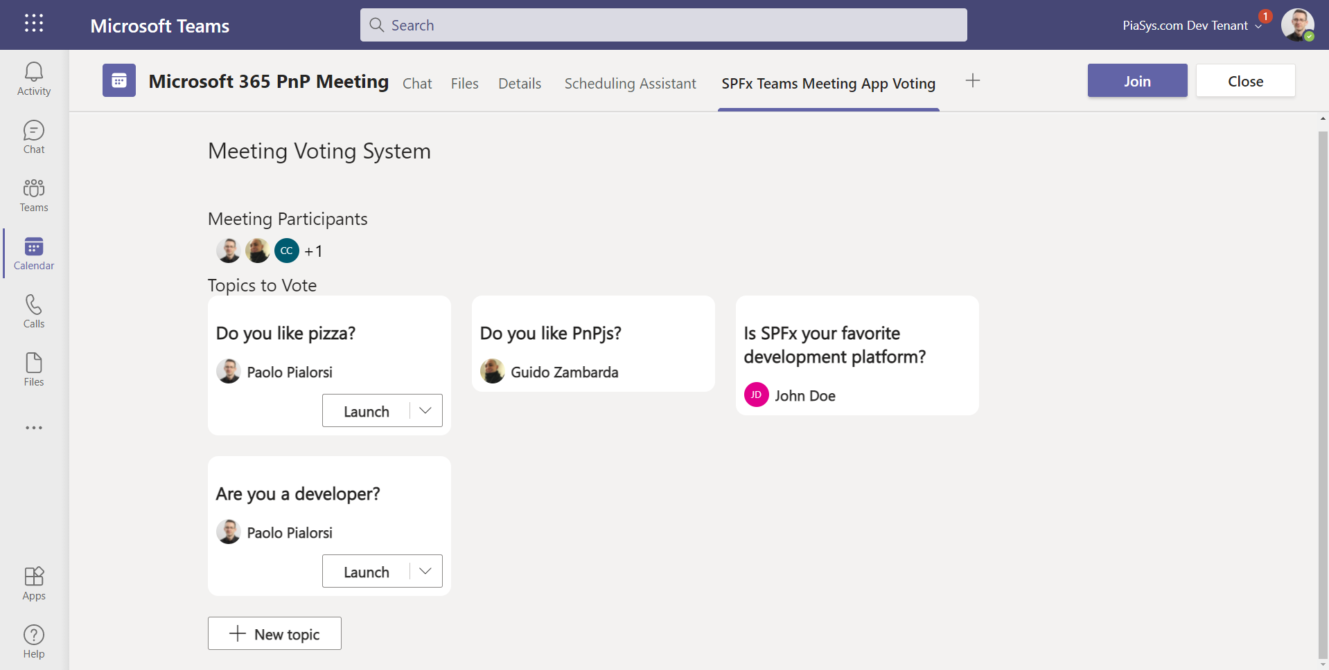
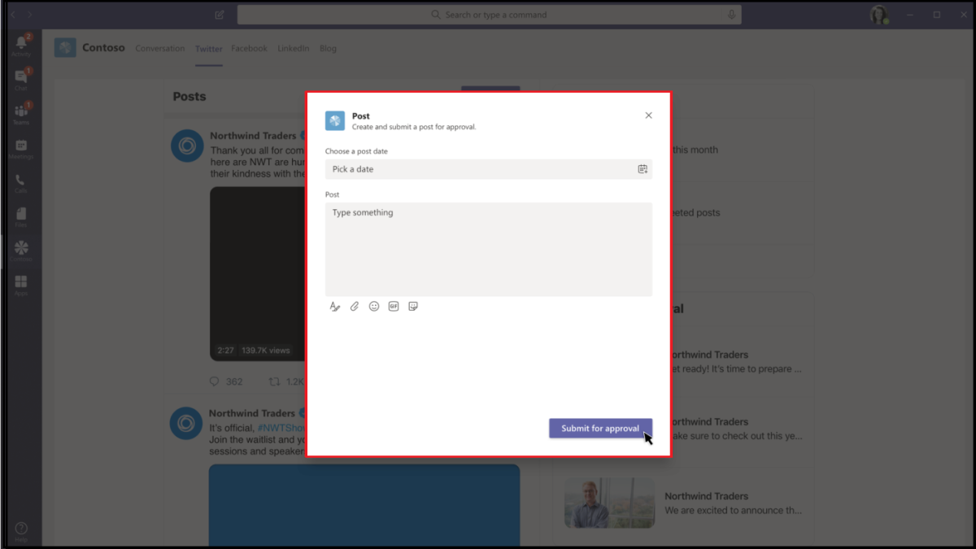
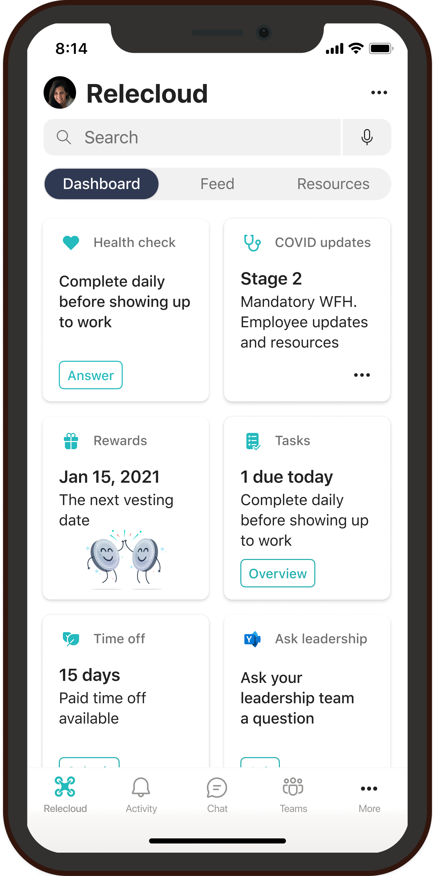
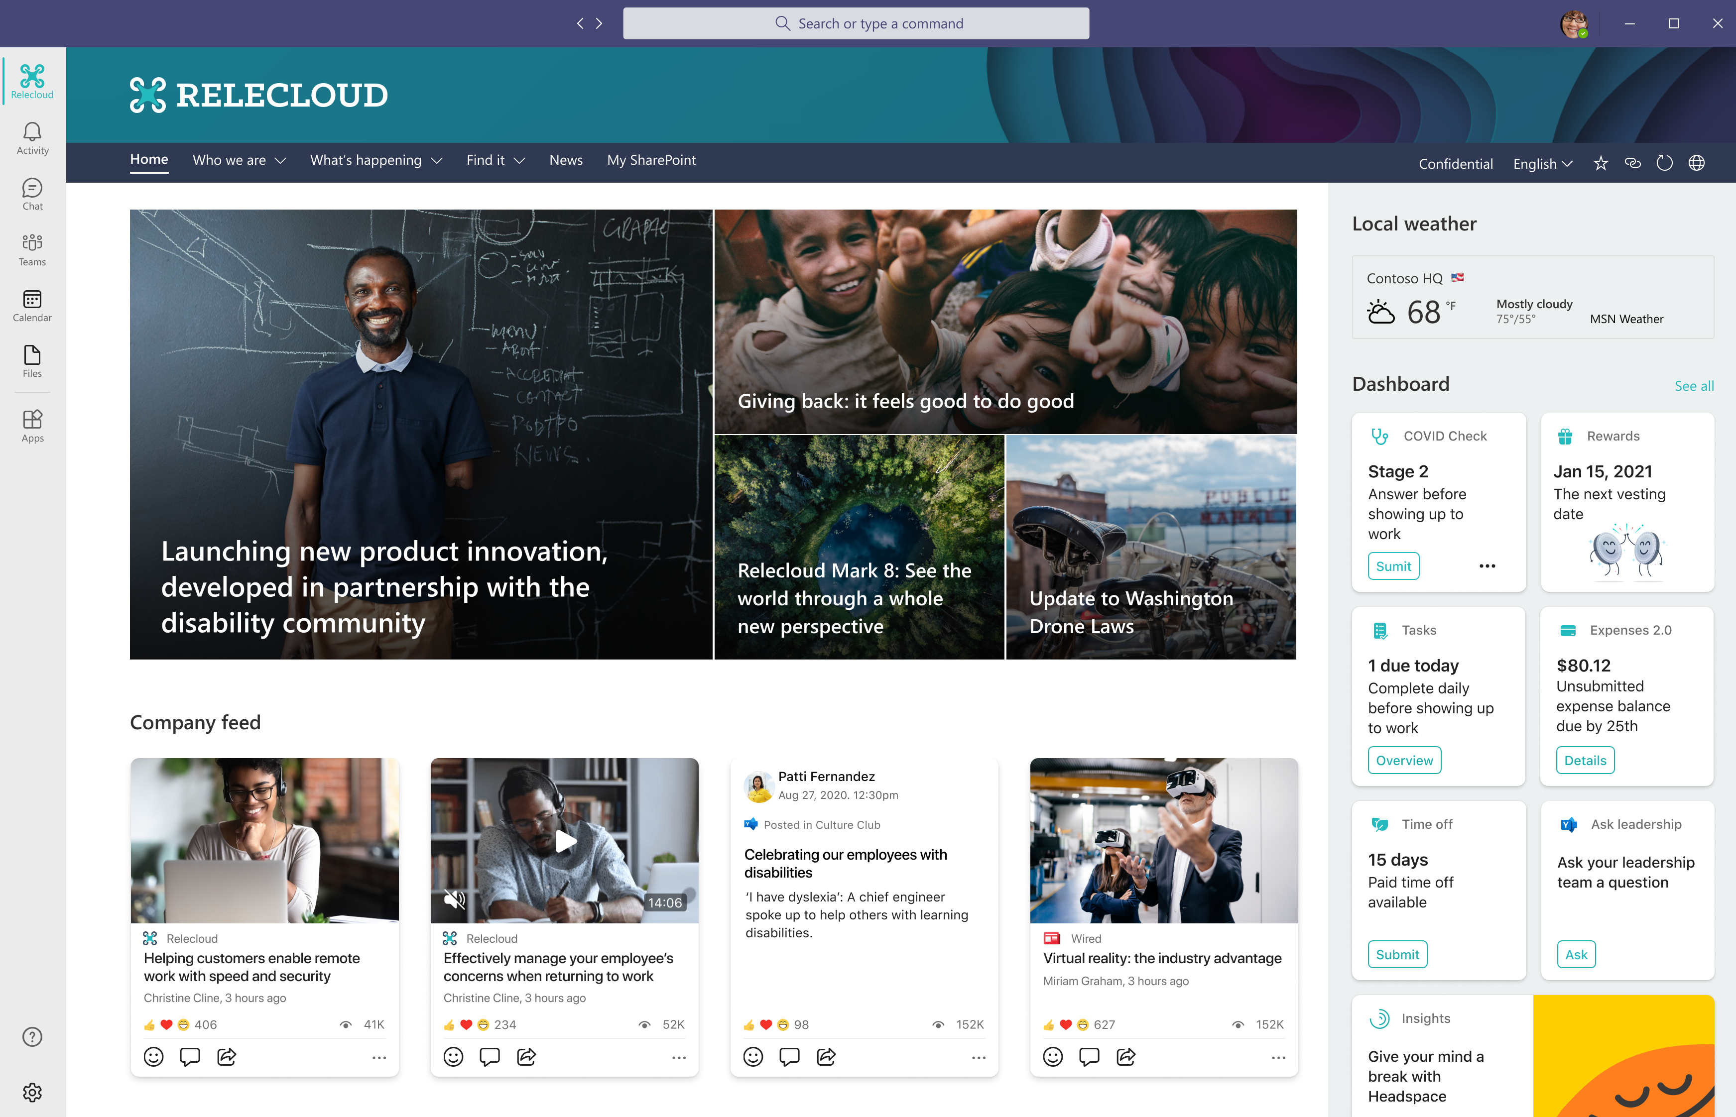
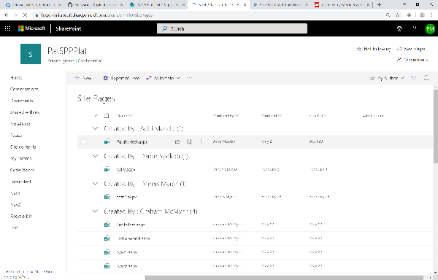
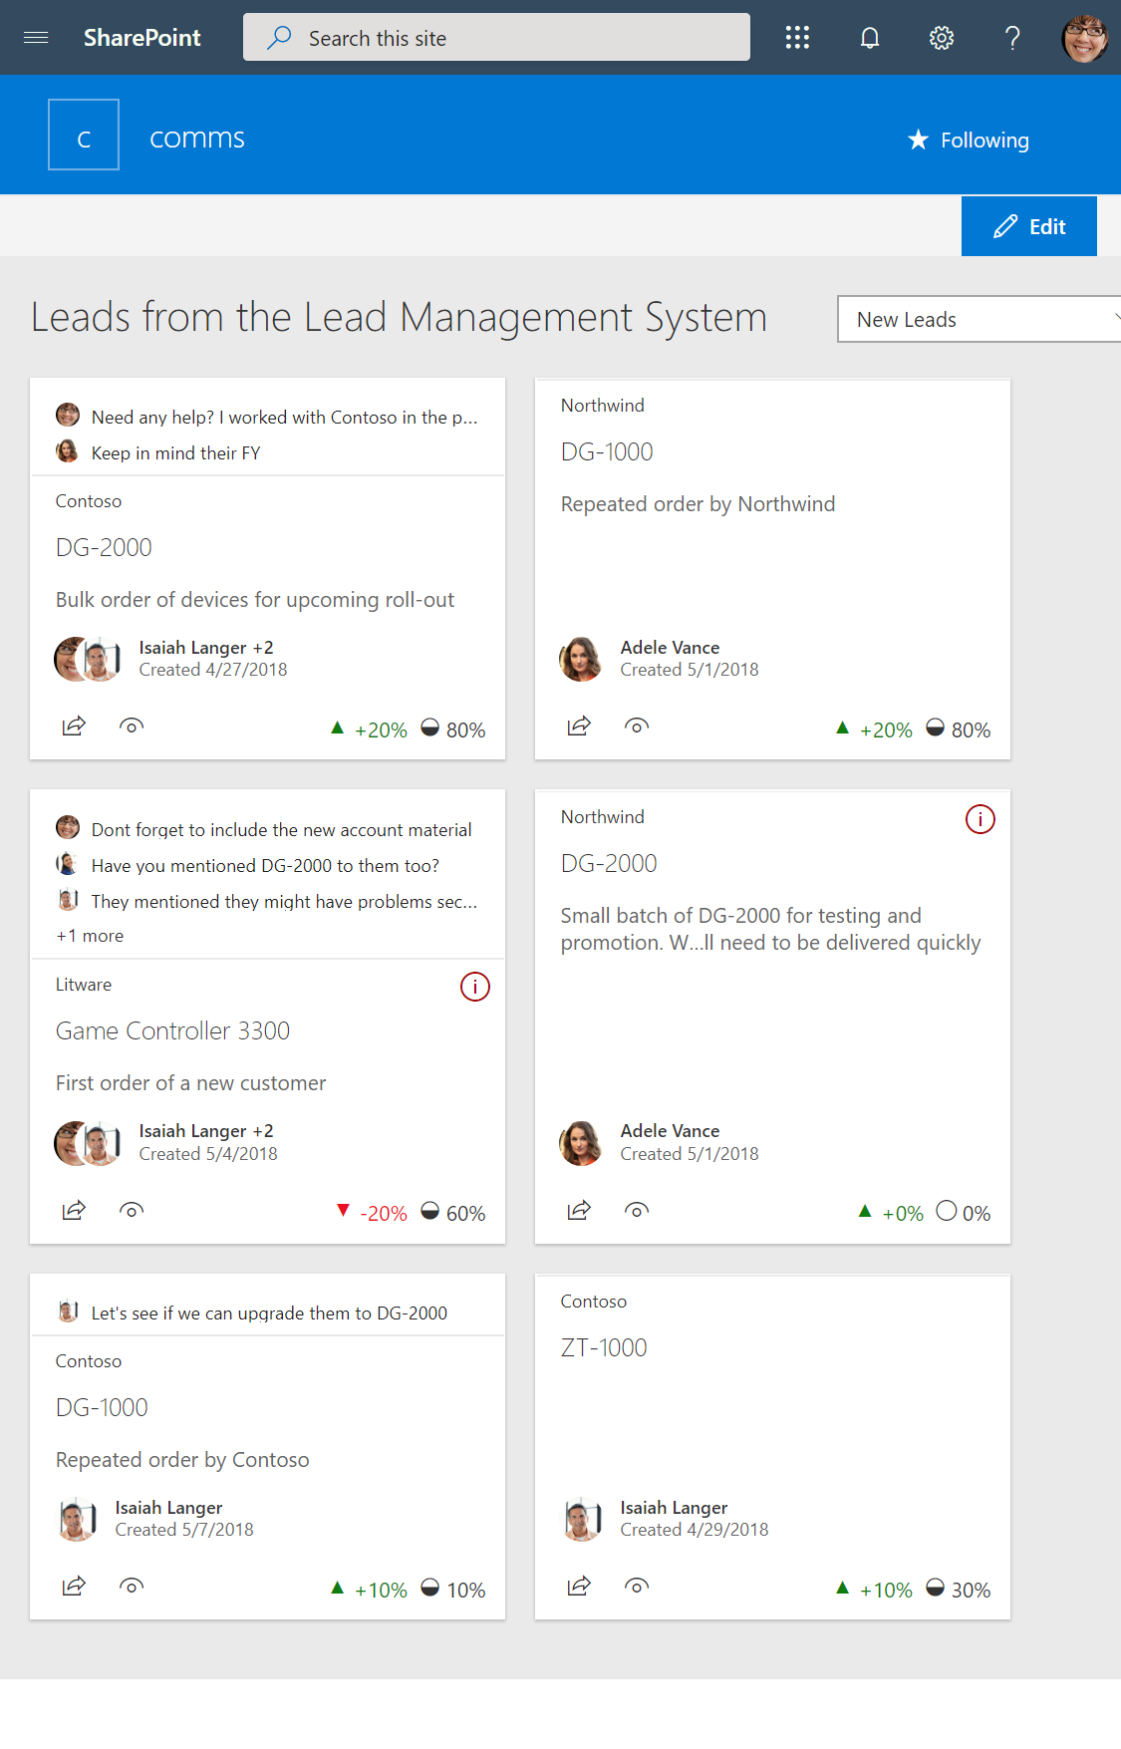
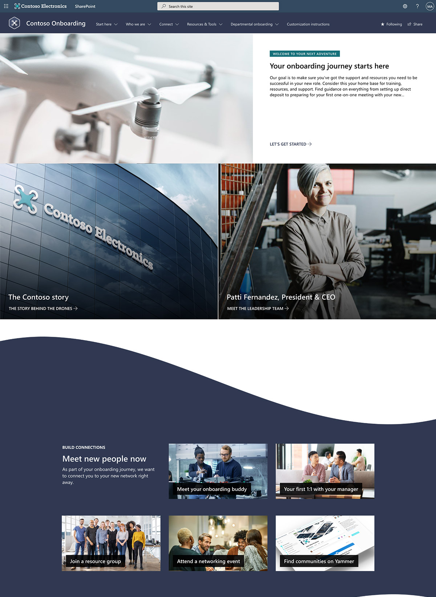
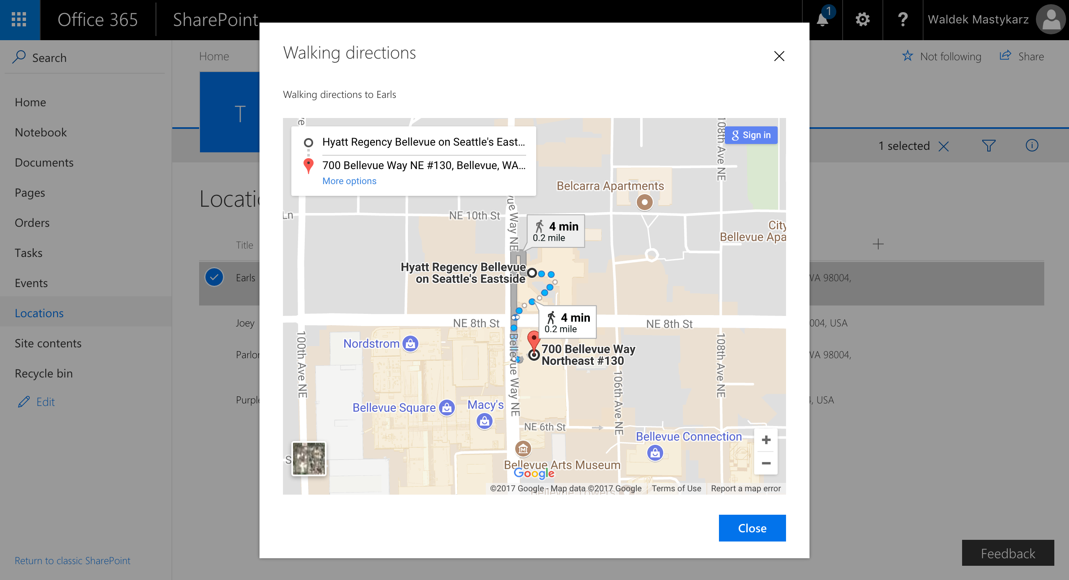
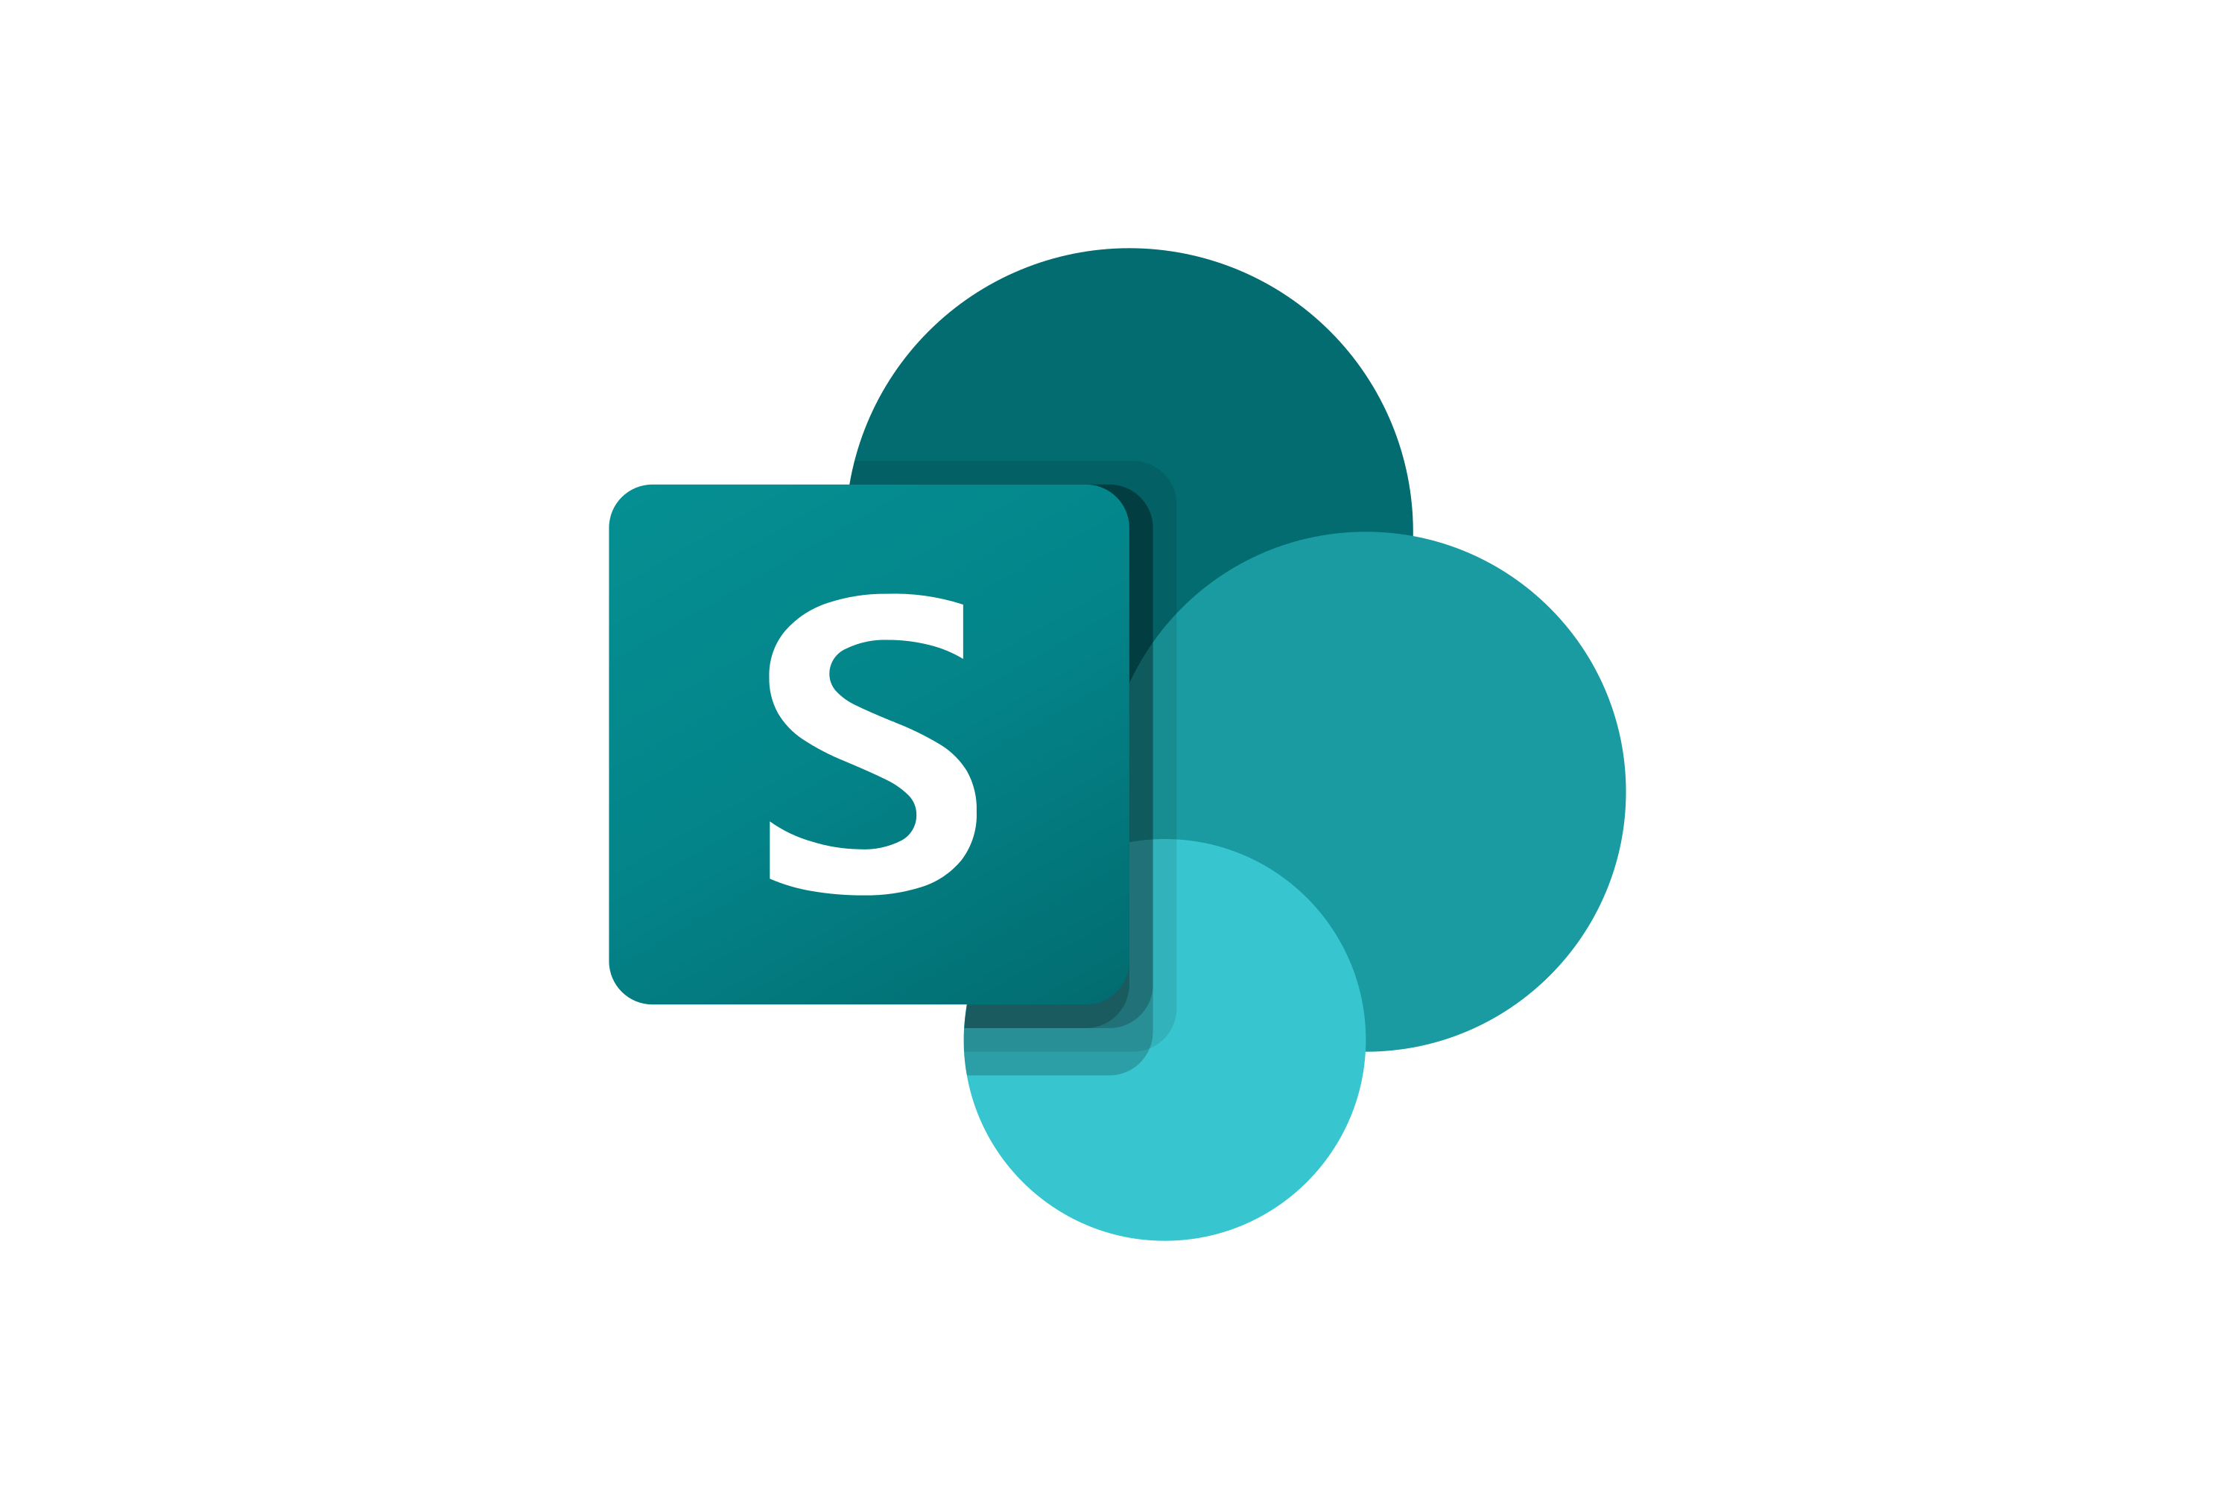
SharePoint Framework experiences in Microsoft 365 The easiest way to build your enterprise solutions for Microsoft Teams, Microsoft Viva and SharePoint Online
Microsoft Teams
Microsoft Viva Connections
Personal Apps
Teams tabs
Meeting apps
Messaging extensions
Cards
Web Parts
Extensions
App pages
SharePoint Online
Content driven applications | SSO | Automatic code hosting | Industry standard tooling
Notes:
We then extended the Framework to extend Teams in content driven experiences across Personal Apps, Teams Tabs and Meeting apps. This allows the entire SharePoint developer community to write content driven apps that work across mobile, web and desktop in Teams and Portals.
This year we introduced new card based extensibility allowing you to create no code apps in Viva Connections and take your existing Teams, SharePoint and Power Apps and target users in your organization with lightweight experiences through Adaptive Cards that take you to richer experiences.
Each time we add a new surface to the SharePoint framework we are honored to see more enterprise developers and ISVs show up to work with the stack. Thank you for continuing to invest your development time and dollars here.

Slide 16
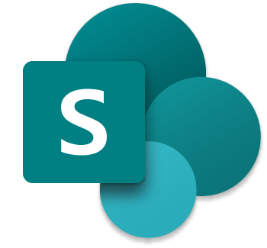
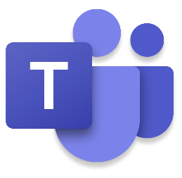

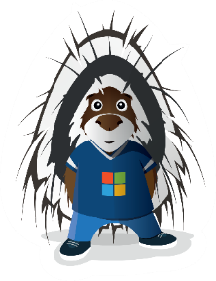
SPFx 1.16 and forward
1.16 preview in upcoming week(s)
New Top Actions support for web parts - Top Actions allow developers to add custom actions to web part's command bar. The feature is like property pane controls but based on cleaner UI approach
Teams JavaScript SDK v2 native support in SPFx solutions – rolling out also to existing solution
Asynchronous support for Viva Connections ACEs rendering
… and more… 🚀
1.16 General Availability in by end of 2022
In development
Bot Framework powered Viva Connections cards
Aligning to Microsoft Teams packaging model – Teams zip file contains also sppkg file
and more across Microsoft Viva, Microsoft Teams and SharePoint

Slide 17
DEMO
Using new web part top actions in Viva Connection desktop or in SharePoint Online

Slide 18
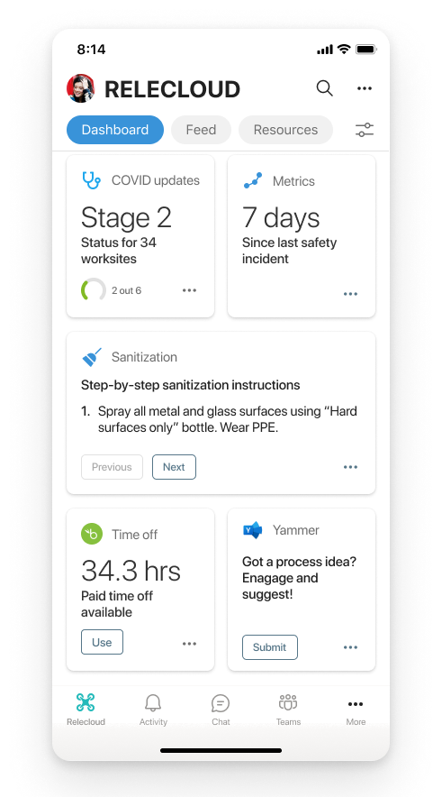
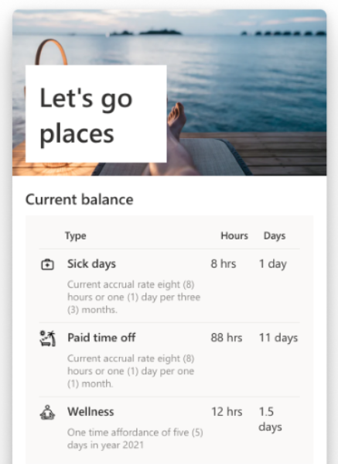
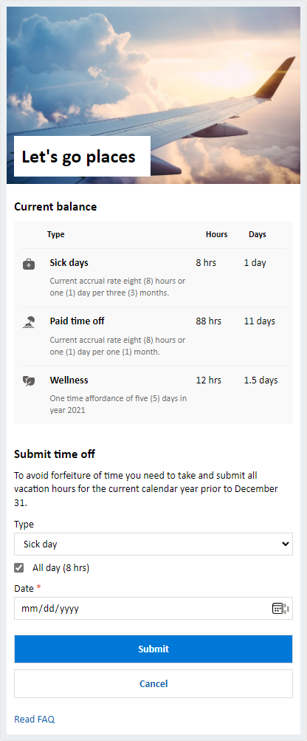

Bot Framework driven Viva Connection cards
ACE cards and quick views
Bot responses and reacts on the Adaptive Card events which are rendered in the Viva Connection dashboard.
Cards provided from the Bot Framework are exposed to be available in the dashboard designer in same way as SPFx cards.
Bot Framework Code
Bot deployed to the tenant and registered to be a source of the Viva Connections Adaptive Cards.
Microsoft Graph other API surfaces

Slide 19
Thank you
Recording will be available in 24 hours on
Microsoft 365 Community (PnP) YouTube channel
https://aka.ms/m365/videos
(subscribe today)
Follow us on Twitter
@Microsoft365Dev | @M365PnP
Next Microsoft 365 Platform call: September 13th at 08:00 am PT
All available community calls from https://aka.ms/m365/calls

Slide 20
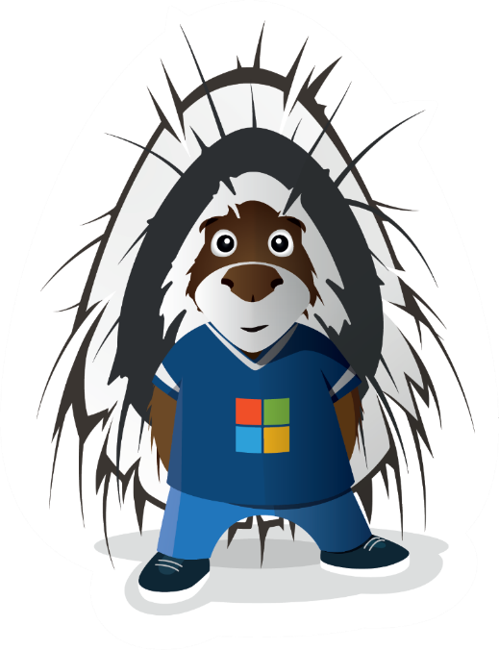


aka.ms/m365pnp

